Slide 1


Site-Specific Propagation Predictions of the Radio Channel Using NYURay Based on Measurements and Ray-Tracing at Upper Mid-Band Frequencies
Mingjun Ying
Advisor: Prof. Theodore S. Rappaport
M.S. Dissertation Defense
April 29, 2025
This research is supported by the NYU WIRELESS Industrial Affiliates Program.

Slide 2
Agenda
3D Scene Reconstruction for Wireless Ray-Tracing
Conclusions and Future Work

Slide 3

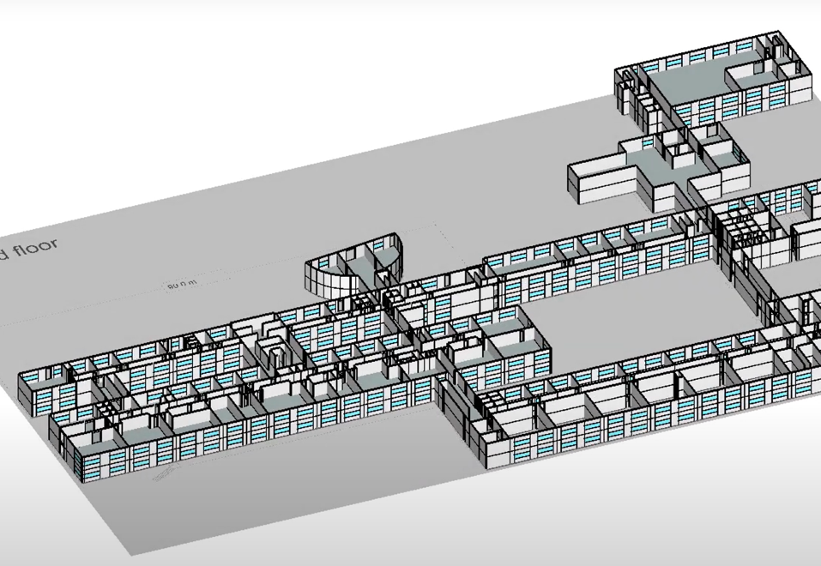
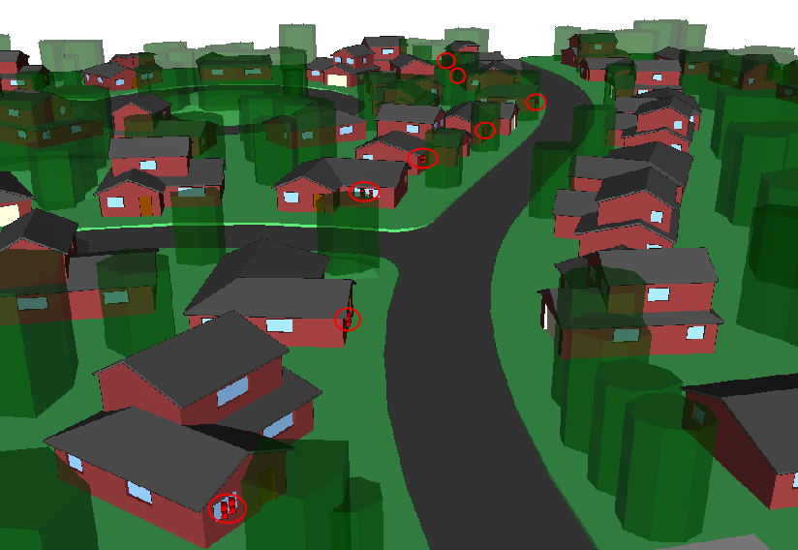
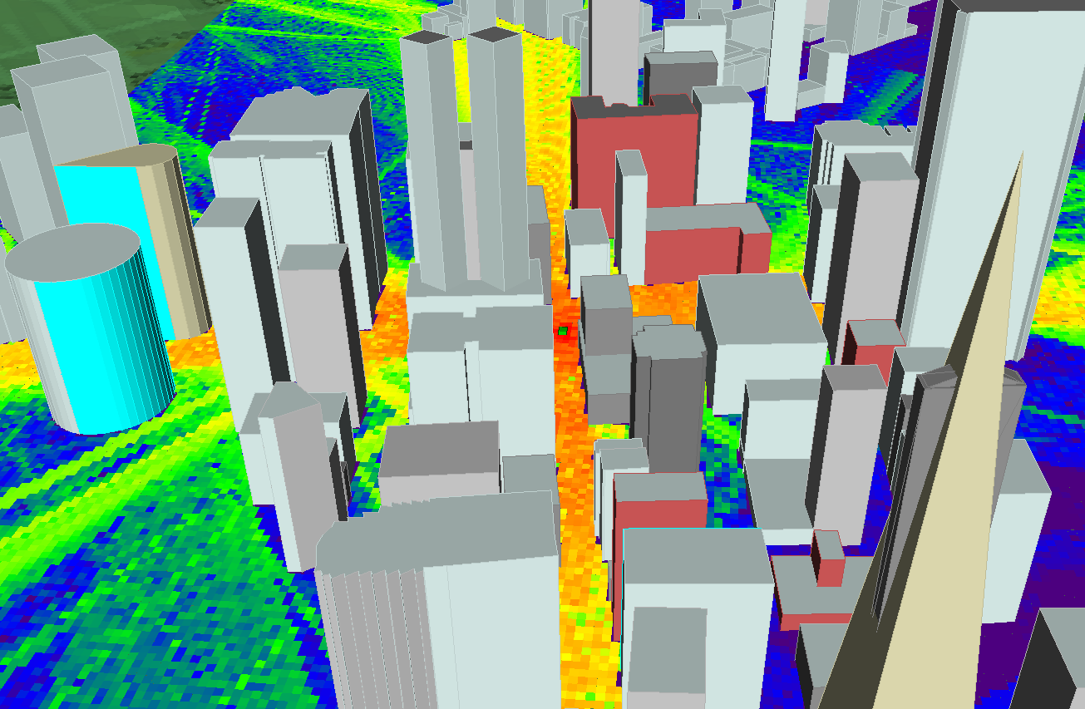
Conventional 3D Reconstruction
Indoor
2.4 m
Rural
Urban
Import AutoCAD 3D files (DXF) to different ray tracer.
[1] Wireless EM Propagation Software | Wireless InSite® | Remcom

Slide 4
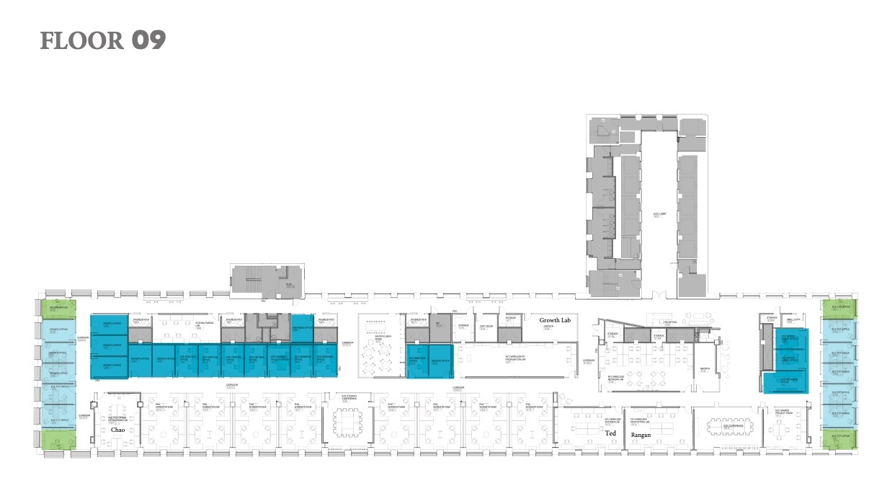
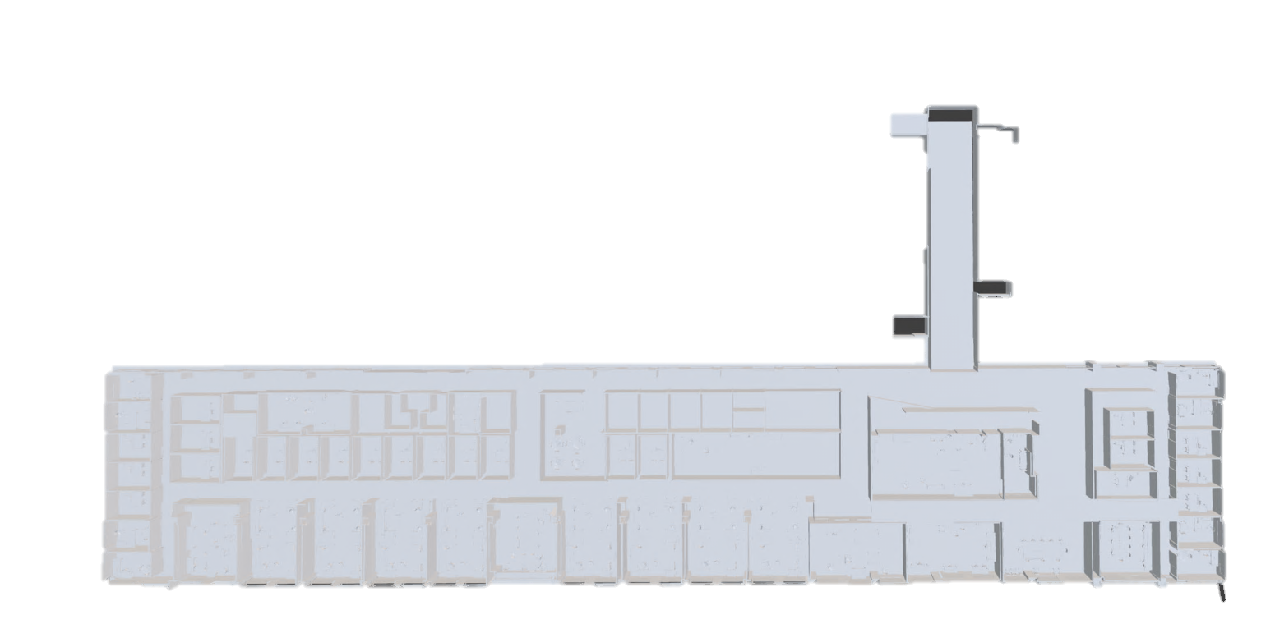
Conventional 3D Reconstruction: Indoor
[1] T. Rappaport and R. Skidmore, “Method and system for a building database manipulator,” U.S. Patent US20 050 131 619A1, Jun. 16, 2005. https://patents.google.com/patent/US20050131619A1

Slide 5
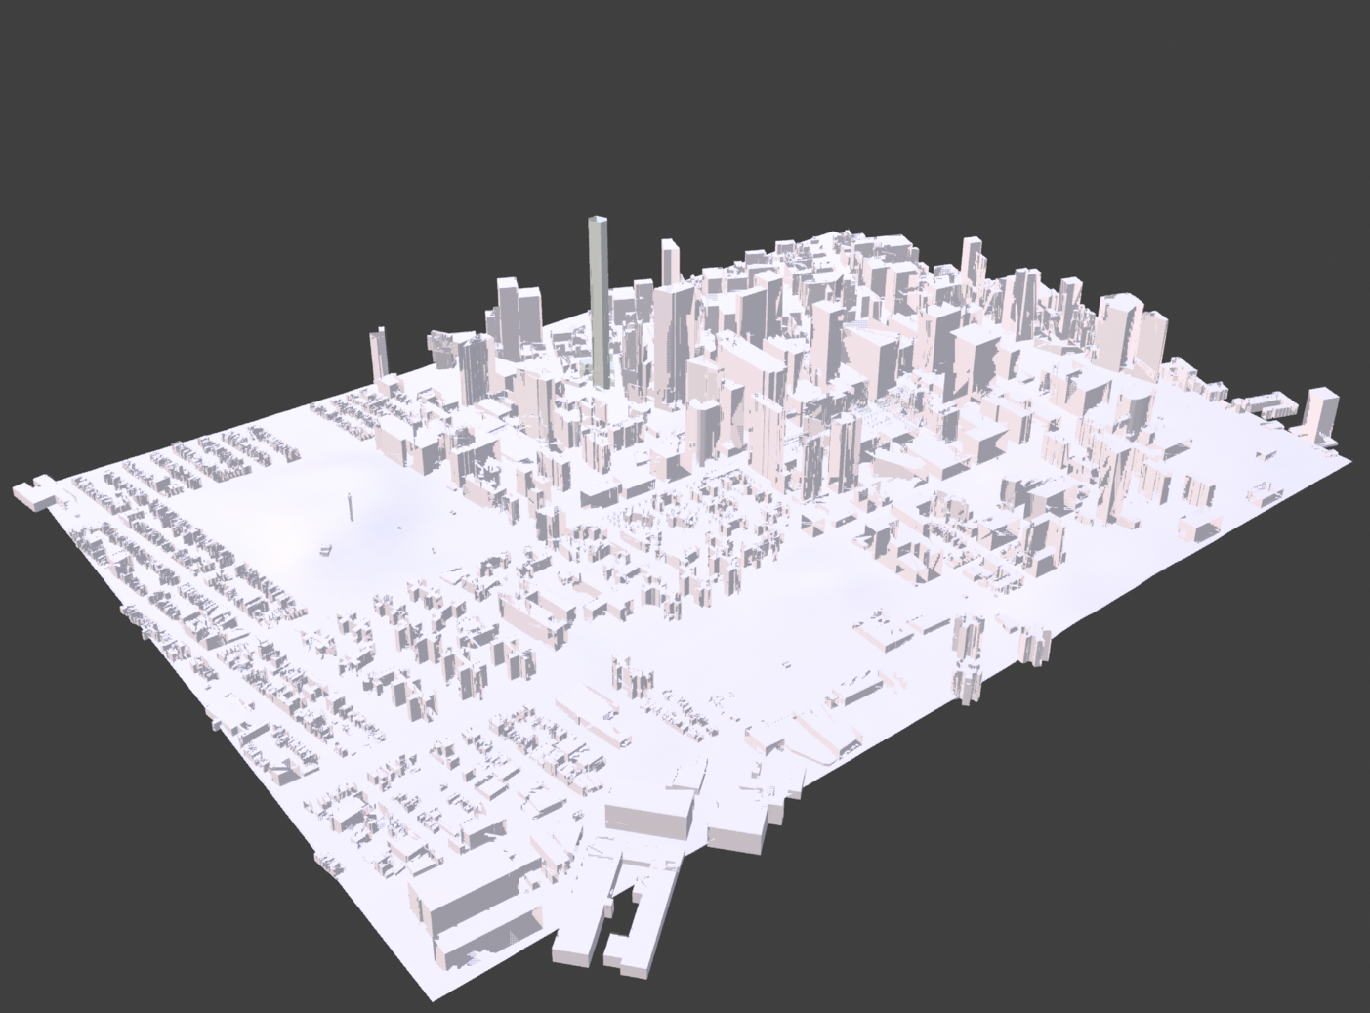
Conventional 3D Reconstruction: Outdoor
Blender Open Street Map (Blosm) add-on [1]
Pros:
Easy to generate.
Building shapes are generally accurate.
Material properties can be assigned easily.
Cons:
Some small objects are missing.
Few building roof shapes are wrong.
Detail of building exterior structure is missing.
2.4 m
[1] Blosm, https://prochitecture.com/blender-osm/extent/?blender_version=4.1&addon=blosm&addon_version=premium2.7.8

Slide 6
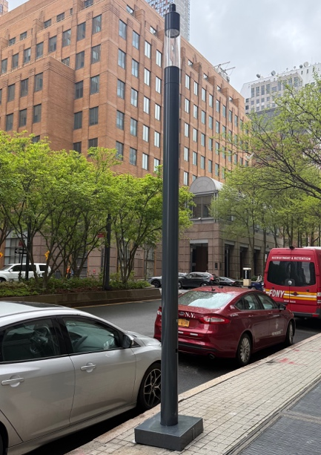
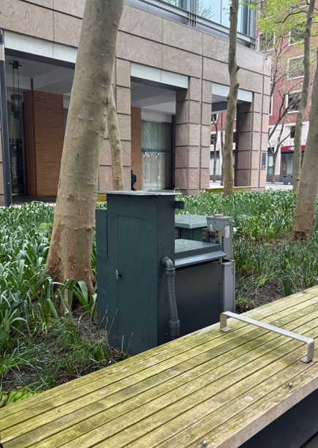
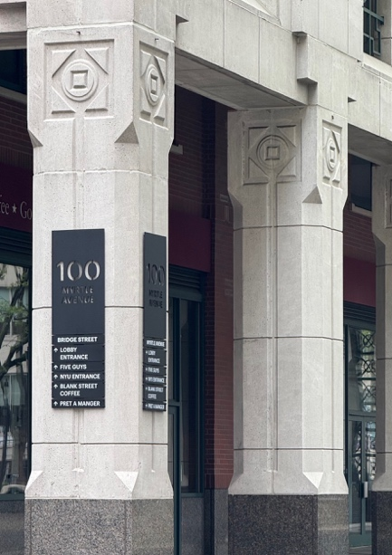
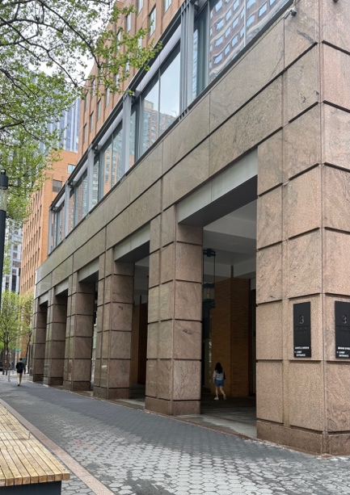
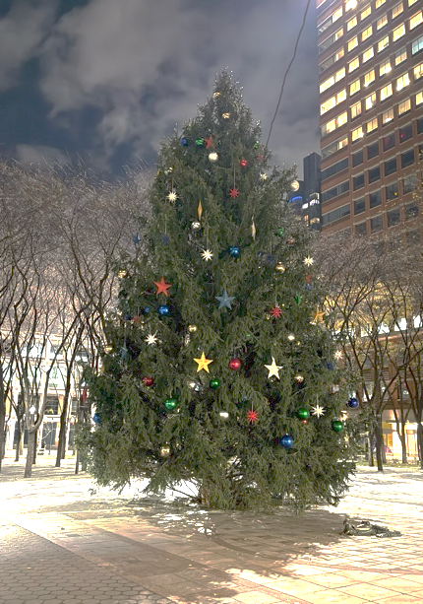
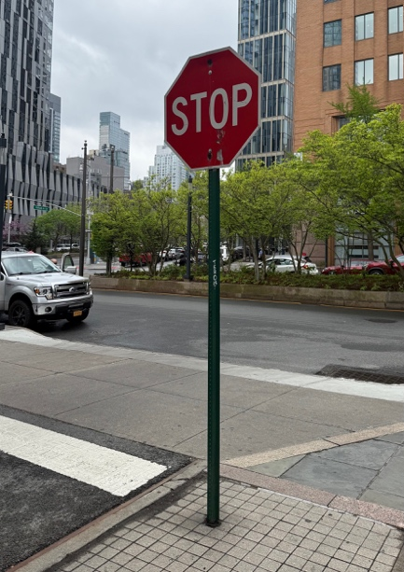
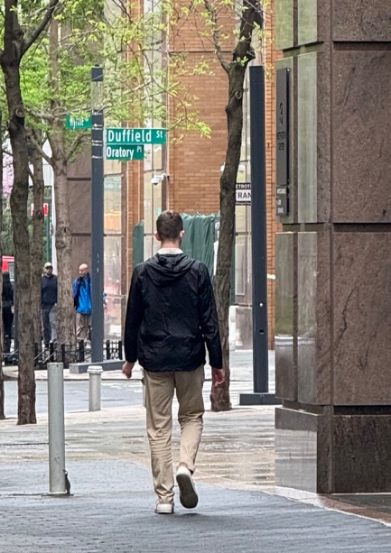
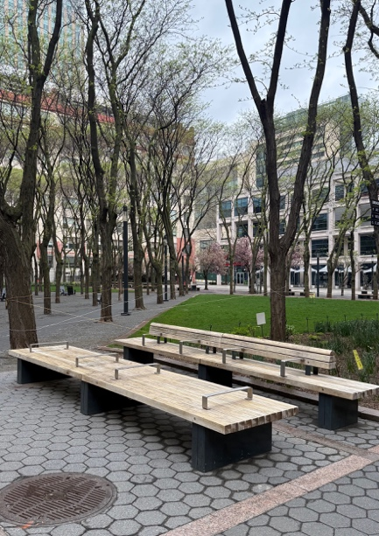
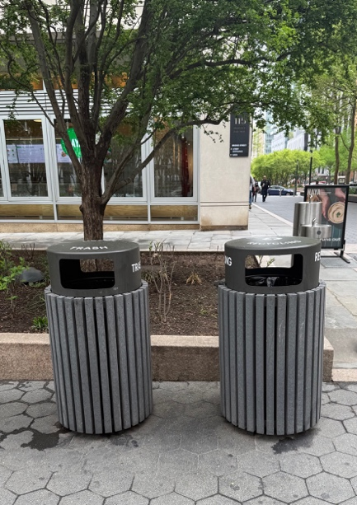
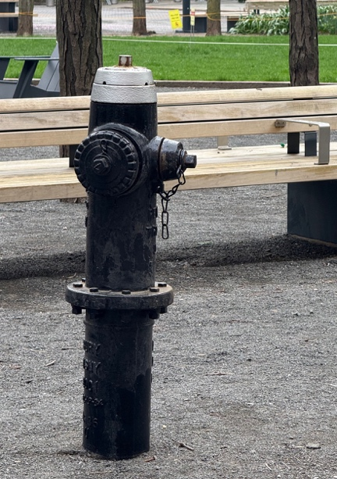
Site-Specific Outdoor UMi Environment
Lamp Post
Transformer
Concrete Pillars
Marble Pillars
Trees and Foliage
Stop Sign
Pedestrians
Bentch
Trash Bin
Fire Hydrant

Slide 7
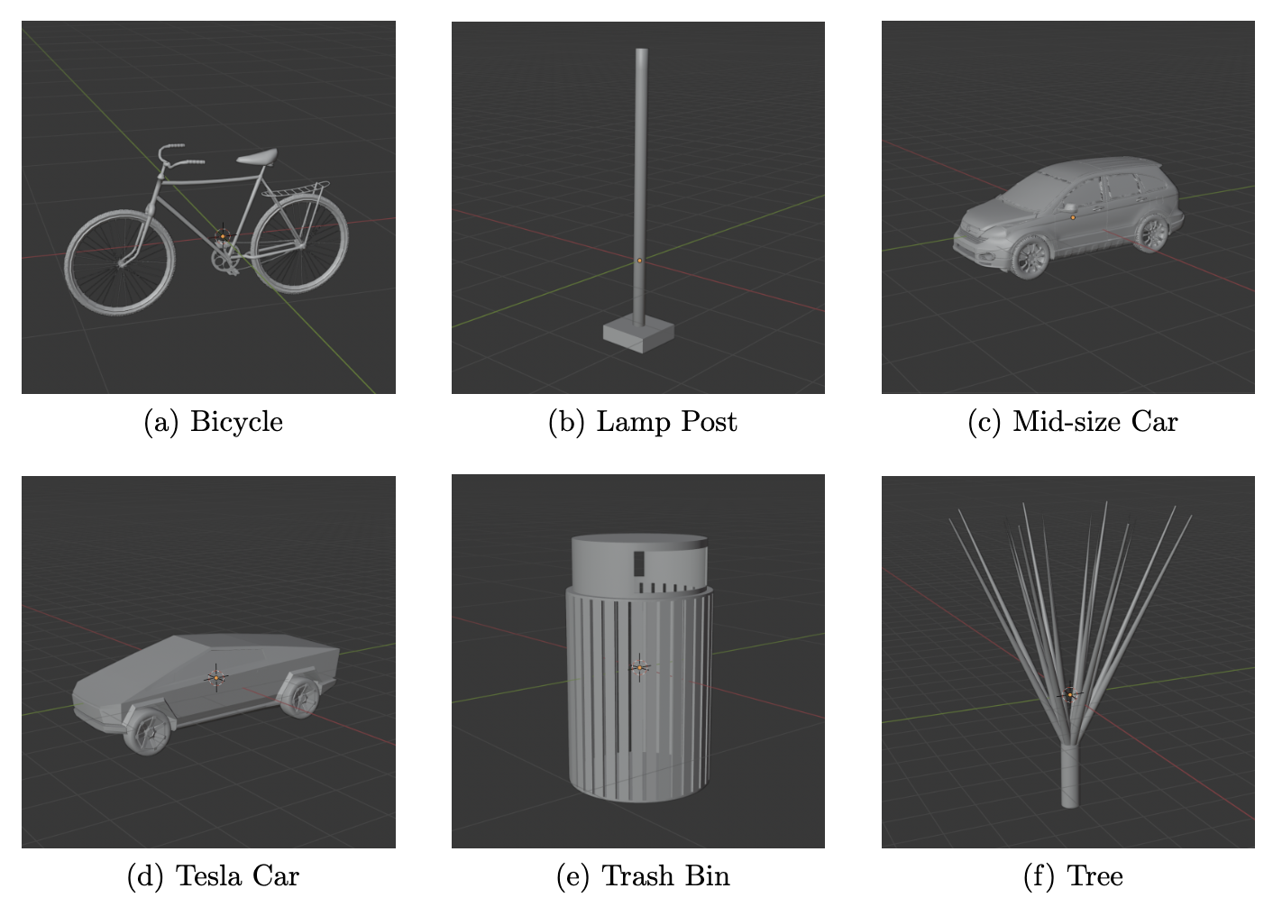
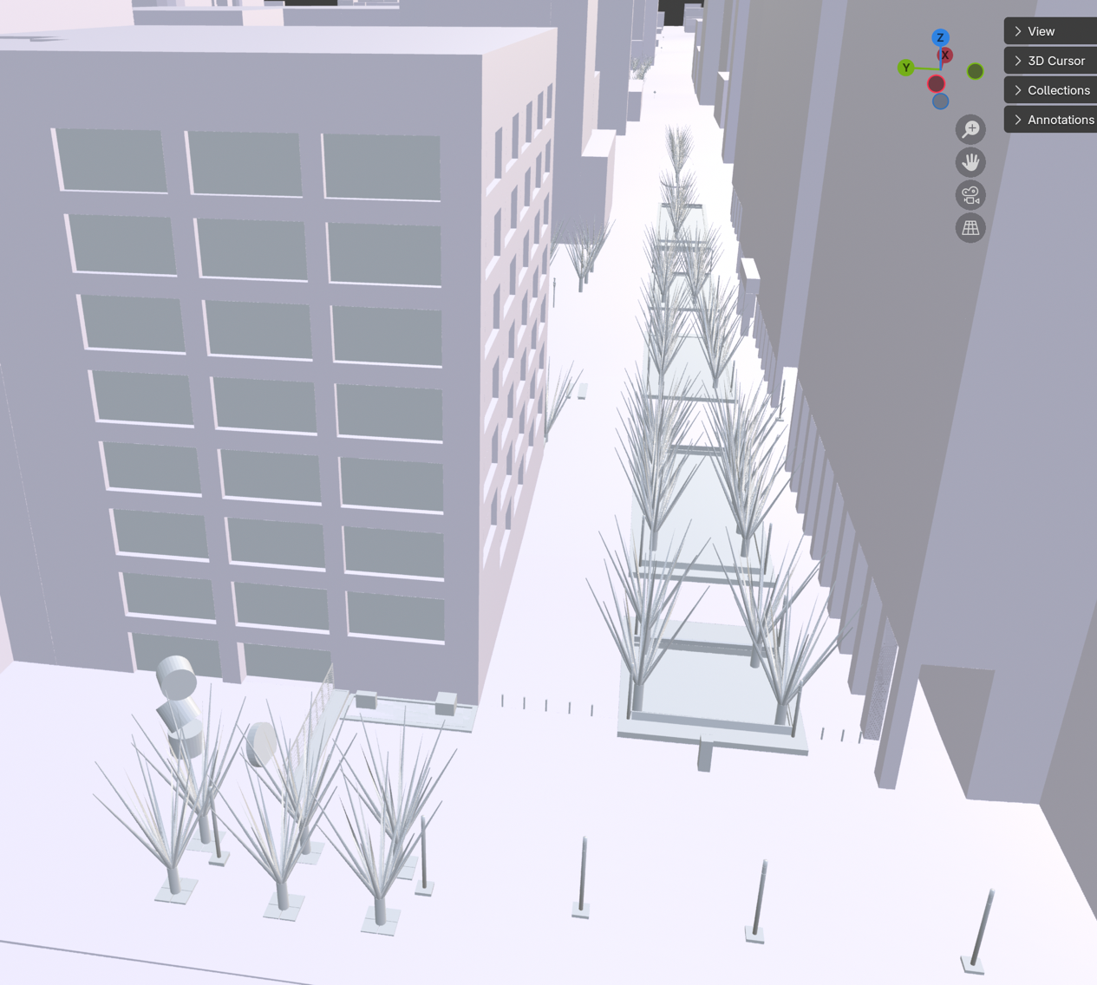
Conventional 3D Reconstruction: Outdoor
Manually Create Missing 3D Objects and Place Objects in Blender
2.4 m
[1] https://prochitecture.com/blender-osm/extent/?blender_version=4.1&addon=blosm&addon_version=premium2.7.8

Slide 8
How Do We Unify 3D Reconstruction?
Main limitation of traditional methods
Time efficiency (manually create each object)
Low accuracy (small cabinets, ventilation tubes, trees, street lights, etc.)
No generalized and uniform database format [1]
What do we want?
Most promising solution:
Low cost
High efficiency
High accuracy
Generalized data format
Computer Vision
Material-Embedded 3D Scene Reconstruction
[1] T. Rappaport and R. Skidmore, Method and system for a building database manipulator, U.S. Patent 6,721,769, Apr. 13, 2004. https://patentimages.storage.googleapis.com/56/39/20/f1a9320fa181a0/US6721769B1.pdf

Slide 9
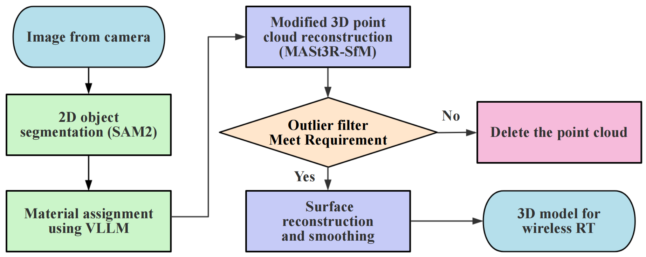
Material-Embedded 3D Reconstruction
Modified Approach
Data Preparation

Slide 10
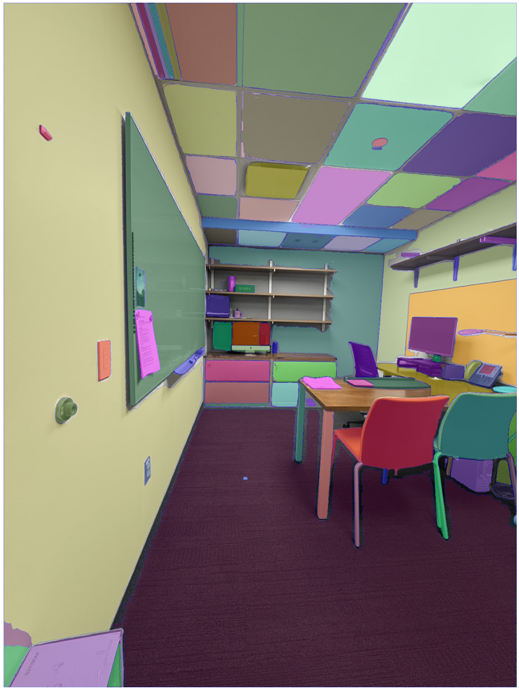
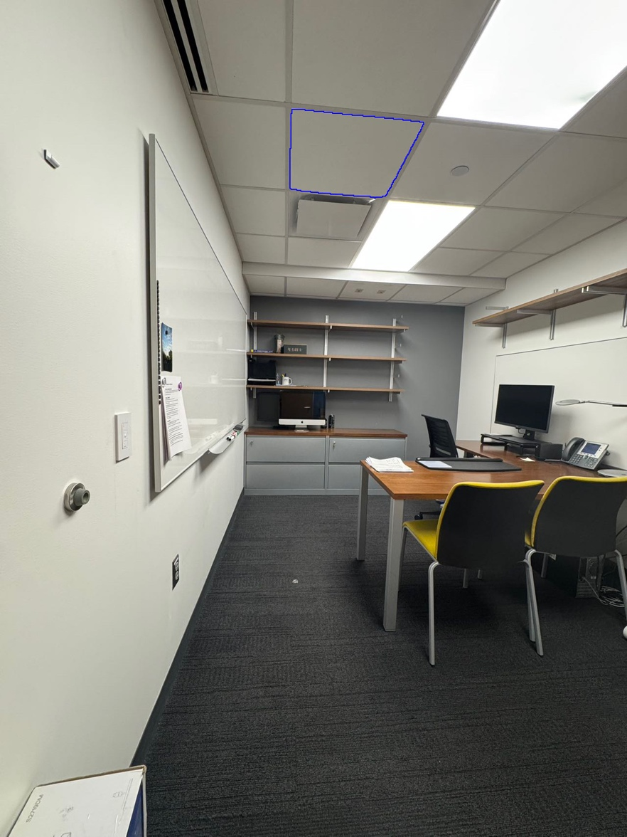
2D Image Segmentation
Segmentation Anything 2 (SAM2)
[1] Nikhila Ravi, Valentin Gabeur, Yuan-Ting Hu, Ronghang Hu , Chaitanya Ryali, Tengyu Ma, Haitham Khedr, Roman R¨adle, Chloe Rolland, Laura Gustafson, et al. Sam 2: Segment anything in images and videos. arXiv:2408.00714, 2024. https://arxiv.org/abs/2408.00714

Slide 11
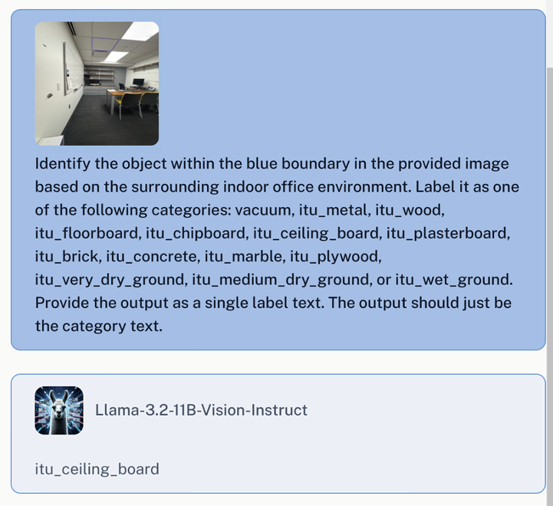
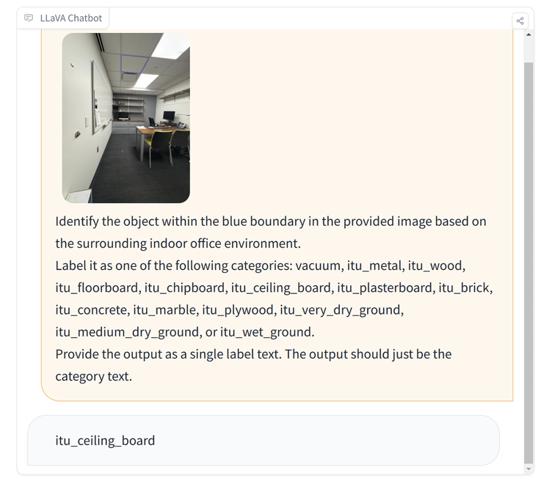
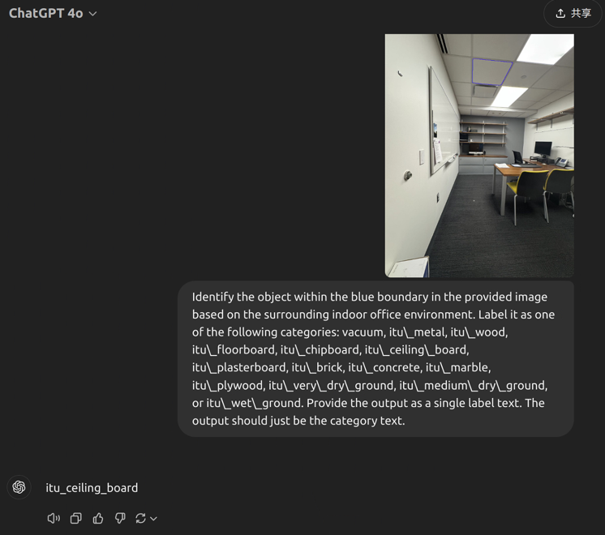
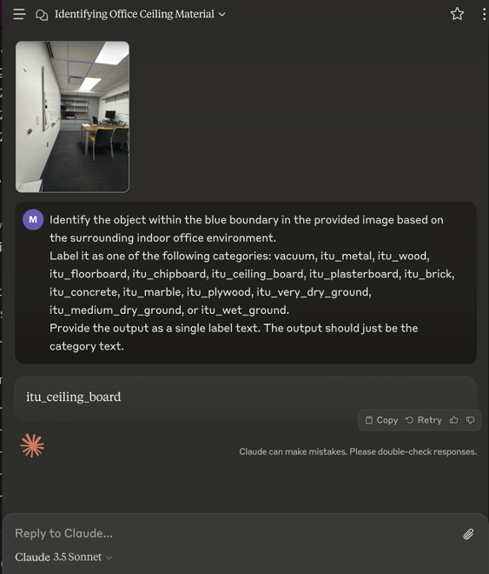
Material Assignment
Performance of Different VLLM
Llama-3.2 11B Vision [1]
LLava v1.5 13B-4bit Vision [2]
ChatGPT-4 Vision [3]
Claude 3.5 Sonnet [4]
All of them successfully identify the material as “itu_celling_board”,
but the small model (<7B parameters) performance is not satisfying,
need to train our own model for identifying material of different objects.
[1] Meta, "LLaMA 3.2: Vision edge for mobile devices," Meta AI, 2024. https://ai.meta.com/blog/llama-3-2-connect-2024-vision-edge-mobile-devices/
[2] K. Lee et al., "LLaVA v1.5 13B-4bit: Large vision-language model for detailed analysis," arXiv, 2023. https://arxiv.org/abs/2304.08485
[3] OpenAI, "GPT-4," OpenAI, 2024. [Online]. Available: https://openai.com/index/gpt-4/
[4] Anthropic, "Claude 3.5 Sonnet: Advanced multimodal language model," Anthropic, 2024. https://www.anthropic.com/news/claude-3-5-sonnet

Slide 12
Indoor 3D Environment Reconstruction
Modified Approach
Point Cloud Generation with Material Information Embedded.

Slide 13
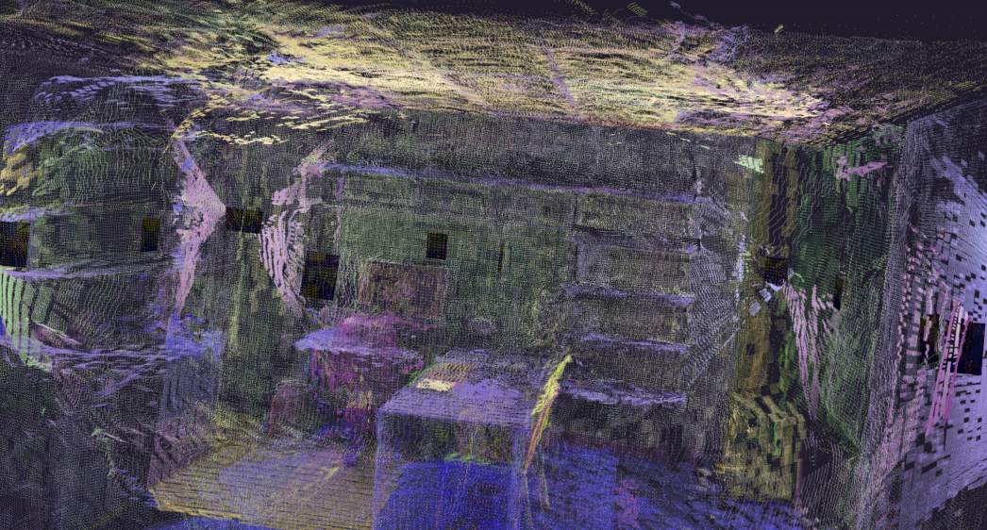
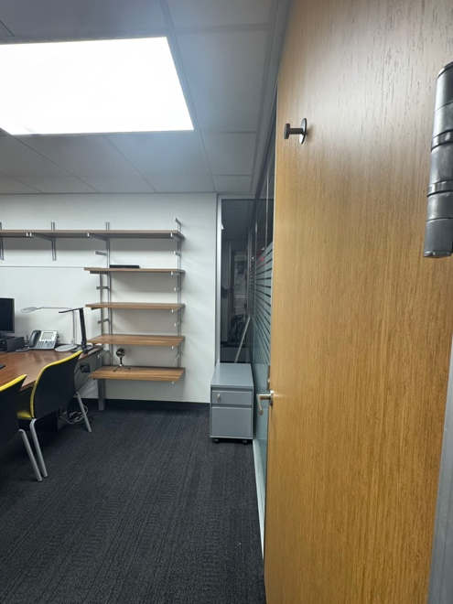
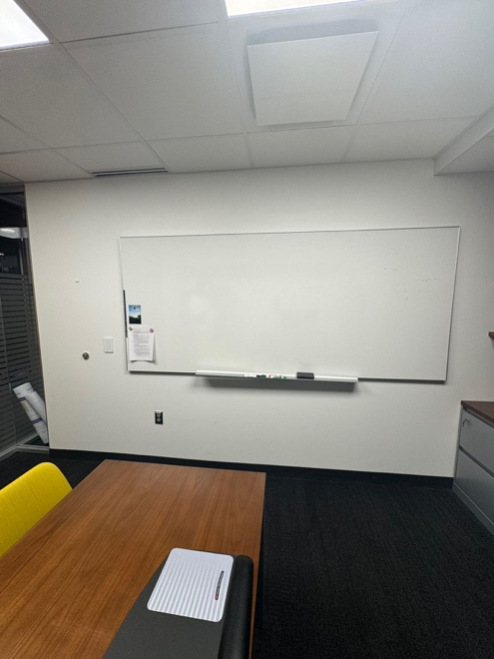
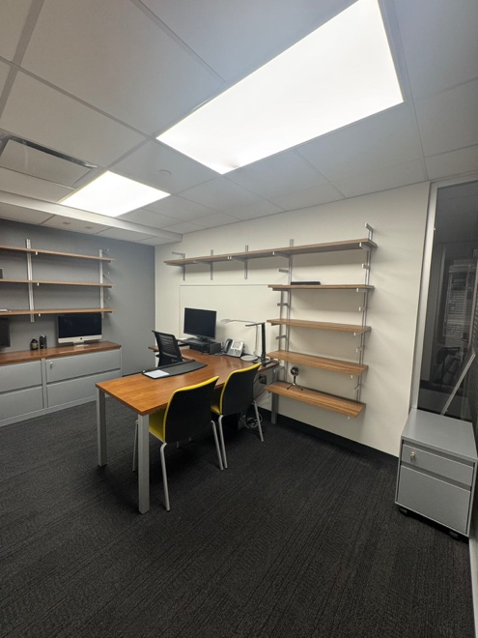
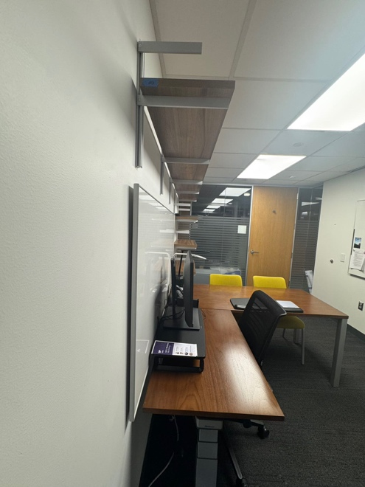
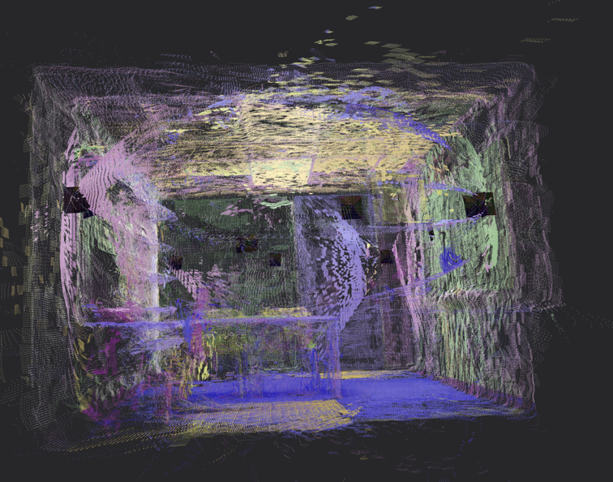
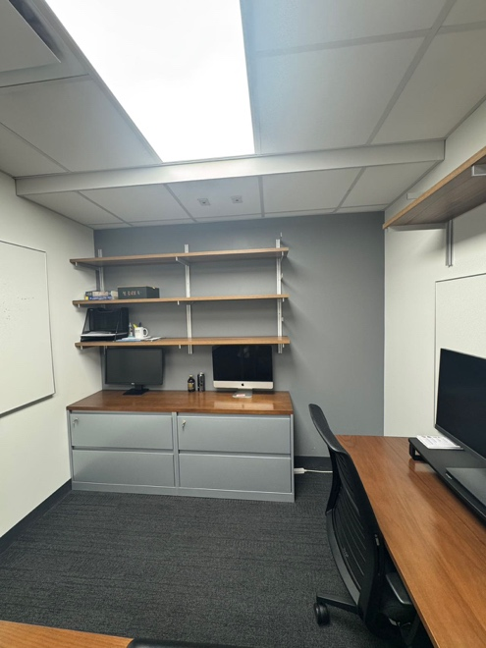
Material-Embedded 3D Point Cloud
Material Information Embedded
[1] V. Leroy, Y. Cabon, and J. Revaud, "Grounding Image Matching in 3D with MASt3R," arXiv preprint arXiv:2406.09756, 2024. https://arxiv.org/abs/2406.09756

Slide 14
Indoor 3D Environment Reconstruction
Modified Approach

Slide 15
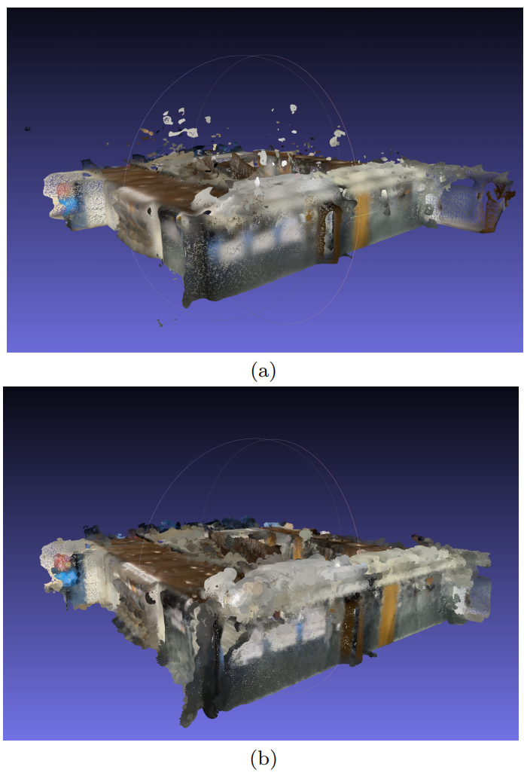
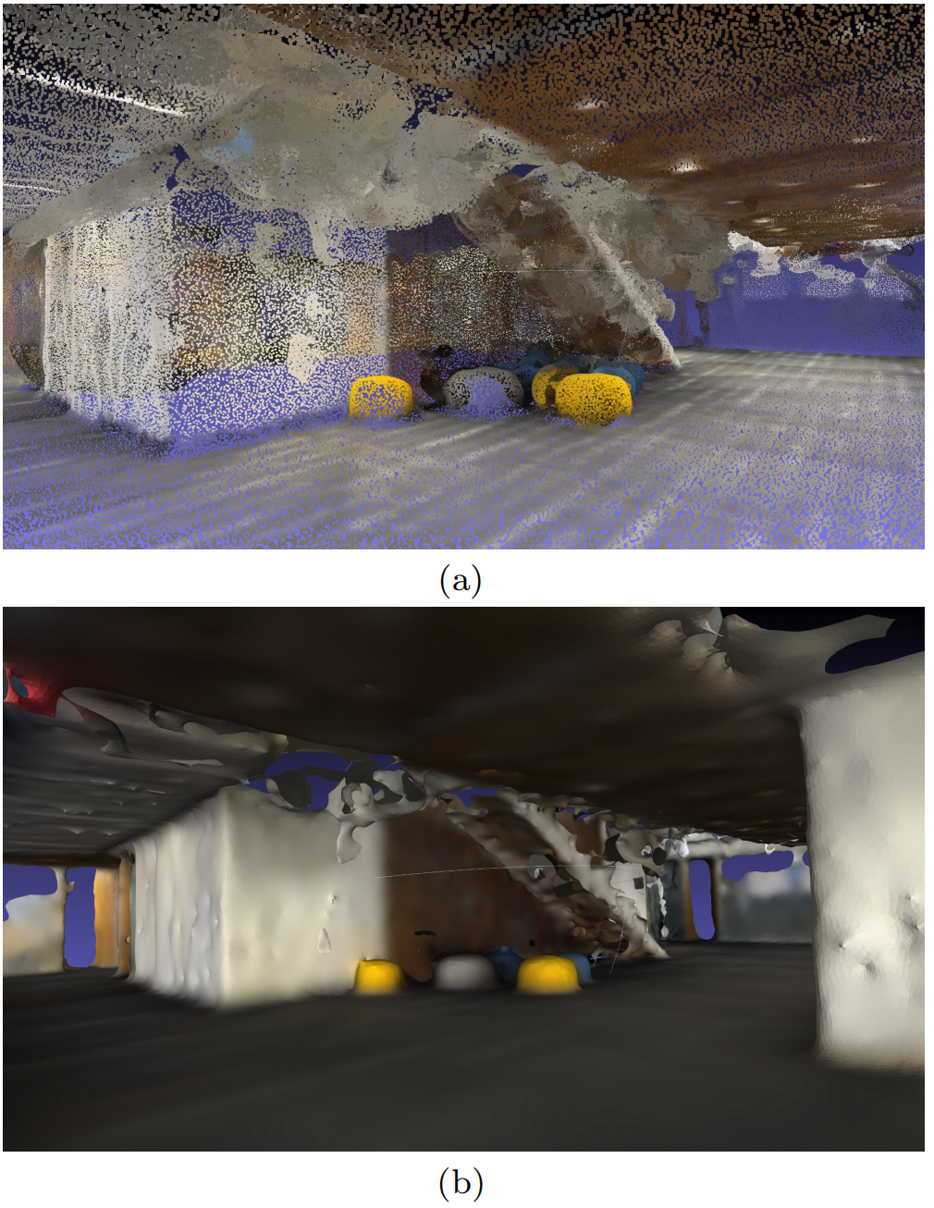
Indoor 3D Environment Reconstruction
Raw Point Cloud
Open3D [1]
RANSAC [2]
Laplacian smoothing [3]
Processed Point Cloud
[1] Q.-Y. Zhou, J. Park, and V. Koltun, “Open3D: A modern library for 3D data processing,” arXiv preprint arXiv:1801.09847, 2018. https://arxiv.org/abs/1801.09847
[2] O. Chum, J. Matas, and J. Kittler, “Locally optimized RANSAC,” in Joint Pattern Recognition Symposium, Springer, 2003, pp. 236–243. https://link.springer.com/chapter/10.1007/978-3-540-45243-0_31
[3] D. A. Field, “Laplacian smoothing and Delaunay triangulations,” Commun. Appl. Numer. Methods, vol. 4, no. 6, pp. 709–712, 1988. https://onlinelibrary.wiley.com/doi/epdf/10.1002/cnm.1630040603

Slide 16
Agenda
3D Scene Reconstruction for Wireless Ray-Tracing
Conclusions and Future Work

Slide 17
Limitations of Current Methods
Impact on Ray Tracing Accuracy
High sensitivity to mesh irregularities – Small errors can significantly distort ray paths
Boundary artifacts (e.g., wall–floor junctions) reduce accuracy
Missing geometry and holes in the 3D model affect completeness
Inaccurate material identification weakens EM property assignment
Inefficient computation in creating large-scale scenes
Consequence: Reduced accuracy in electromagnetic propagation predictions

Slide 18
Potential Plan
For Outdoor Environment
Creating object data base (common objects in the outdoor environment)
UAV video/lidar scan for more accurate building shape reconstruction
For Indoor Environment
Floor plan based efficient indoor reconstruction for less detailed 3D representation
Video/Lidar scan aided detail enhancement
Guide for localization with outdoor base station

Slide 19
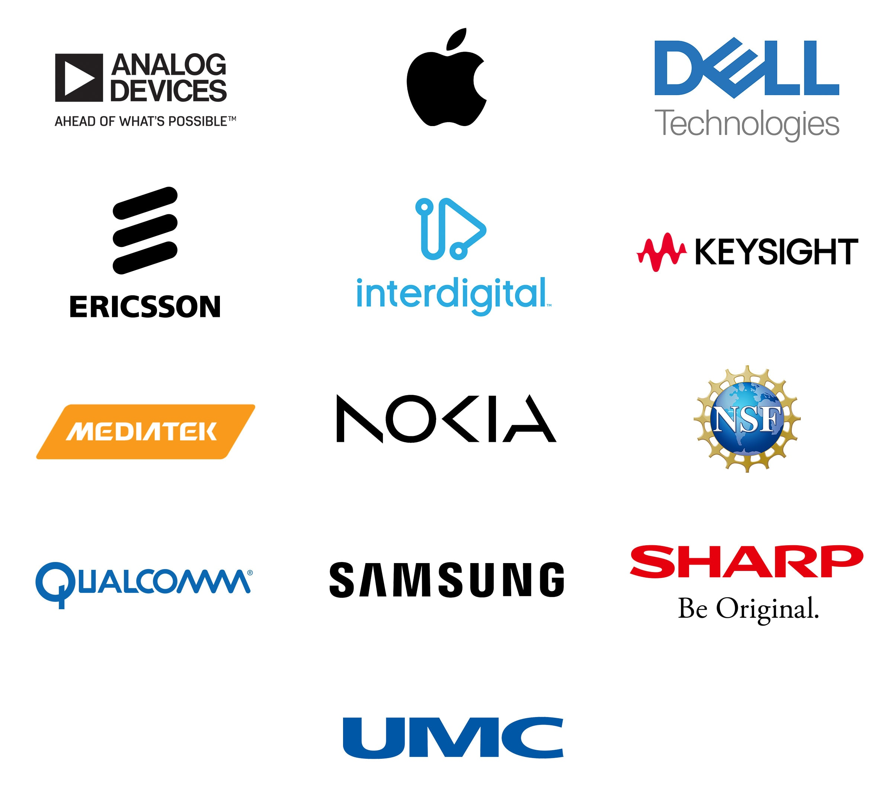
Industrial Affiliates
This work is supported by the NYU WIRELESS Industrial Affiliates Program.

Slide 20
References
[1] M. K. Samimi and T. S. Rappaport, “3-D millimeter-wave statistical channel model for 5G wireless system design,” IEEE Trans. on Microwave Theory and Techniques, vol. 64, no. 7, pp. 2207–2225, July 2016. https://ieeexplore.ieee.org/document/7501500
[2] S. Ju, Y. Xing, O. Kanhere and T. S. Rappaport, "Millimeter Wave and Sub-Terahertz Spatial Statistical Channel Model for an Indoor Office Building," in IEEE Journal on Selected Areas in Communications, vol. 39, no. 6, pp. 1561-1575, June 2021. https://ieeexplore.ieee.org/document/9411894
[3] Remcom, “Wireless InSite,” https://www.remcom.com/wireless-insite-em-propagation-software
[4] iBwave Solutions Inc., “ibwave design prediction accuracy,” 2025. https://www.ibwave.com/storage/app/media/pdf/white-papers/ibwave-design-prediction-accuracy%20white-paper.pdf
[5] EDX, Inc., “Software update release notes,” 2025. https://edx.com/software-update-release-notes/
[6] J. Hoydis, S. Cammerer, F. Ait Aoudia, M. Nimier‑David, L. Maggi, G. Marcus, A. Vem, and A. Keller, “Sionna,” 2022. https://nvlabs.github.io/sionna/
[7] Altair Engineering, Inc., “Altair winprop documentation,” 2025. https://help.altair.com/winprop/index.htm
[8] K. Guan, D. He, and Z. Zhong, “CloudRT: A Chinese example of open science infrastructure and services,” Cultures of Science, vol. 4, no. 4, pp. 217–226, 2021. https://journals.sagepub.com/doi/full/10.1177/20966083221084142
[9] O. Kanhere, H. Poddar and T. S. Rappaport, "Calibration of NYURay for Ray Tracing Using 28, 73, and 142 GHz Channel Measurements Conducted in Indoor, Outdoor, and Factory Scenarios," in IEEE Transactions on Antennas and Propagation, vol. 73, no. 1, pp. 405-420, Jan. 2025. https://ieeexplore.ieee.org/document/10721240
[10] S. Y. Tan and H. S. Tan, “A microcellular communications propagation model based on the uniform theory of diffraction and multiple image theory,” IEEE Trans. Antennas Propag., vol. 44, no. 10, pp. 1317–1326, Oct. 1996. https://ieeexplore.ieee.org/document/537325

